Slide 1
Consumer Perception

Slide 2
Chapter Outline
Elements of Perception
Aspects of Perception
Selection
Organization
Interpretation

Slide 3
Perception
The process by which an individual selects, organizes, and interprets stimuli into a meaningful and coherent picture of the world
How we see the world around us

Slide 4
Elements of Perception
Sensation
Absolute threshold
Differential threshold
Subliminal perception

Slide 5
Sensation
The immediate and direct response of the sensory organs to stimuli
A stimulus is any unit of input to any of the senses.
The absolute threshold is the lowest level at which an individual can experience a sensation.

Slide 6
Differential Threshold
Minimal difference that can be detected between two similar stimuli
Also known as the just noticeable difference (the j.n.d.)

Slide 7
Weber’s Law
The j.n.d. between two stimuli is not an absolute amount but an amount relative to the intensity of the first stimulus
Weber’s law states that the stronger the initial stimulus, the greater the additional intensity needed for the second stimulus to be perceived as different.

Slide 8
Marketing Applications of the J.N.D.
Marketers need to determine the relevant j.n.d. for their products
so that negative changes are not readily discernible to the public
so that product improvements are very apparent to consumers

Slide 9
Discussion Question
How might a cereal manufacturer such as Kellogg’s use the j.n.d. for Fruit Loops in terms of:
Product decisions
Packaging decisions
Advertising decisions
Sales promotion decisions.

Slide 10
Subliminal Perception
Stimuli that are too weak or too brief to be consciously seen or heard may be strong enough to be perceived by one or more receptor cells.

Slide 11
Is Subliminal Persuasion Effective?
Extensive research has shown no evidence that subliminal advertising can cause behavior changes
Some evidence that subliminal stimuli may influence affective reactions

Slide 12
Aspects of Perception
Selection
 | Organization
 |  | Interpretation

Slide 13
Aspects of Perception
Selection
 | Organization
 |  | Interpretation

Slide 14
Perceptual Selection
Consumers subconsciously are selective as to what they perceive.
Stimuli selected depends on two major factors
Consumers’ previous experience
Consumers’ motives
Selection depends on the
Nature of the stimulus
Expectations
Motives

Slide 15
Discussion Questions
What marketing stimuli do you remember from your day so far?
Why do you think you selected these stimuli to perceive and remember?

Slide 16
Perceptual Selection
Concepts
Selective Exposure
Selective Attention
Perceptual Defense
Perceptual Blocking
Consumers seek out messages which:
Are pleasant
They can sympathize
Reassure them of good purchases

Slide 17
Perceptual Selection
Concepts
Selective Exposure
Selective Attention
Perceptual Defense
Heightened awareness when stimuli meet their needs
Consumers prefer different messages
and medium
•
Perceptual
Blocking

Slide 18
Perceptual Selection
Concepts
Selective Exposure
Selective Attention
Perceptual Defense
Screening out of stimuli which are threatening
•
Perceptual
Blocking

Slide 19
Perceptual Selection
Concepts
Selective Exposure
Selective Attention
Perceptual Defense
Perceptual Blocking
Consumers avoid being bombarded by:
Tuning out
TiVo

Slide 20
Aspects of Perception
Selection
 | Organization
 |  | Interpretation

Slide 21
Organization
Principles
Figure and ground
Grouping
Closure
People tend to organize perceptions into figure-and-ground relationships.
The ground is usually hazy.
Marketers usually design so the figure is the noticed stimuli.

Slide 22
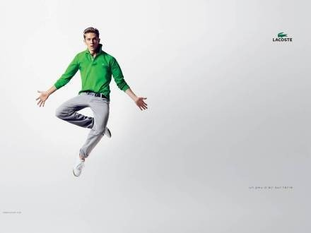
Lacoste’s campaign uses a very plain ground so the symbol really
shows.
weblink

Slide 23
Organization
Principles
Figure and ground
Grouping
Closure
People group stimuli to form a unified impression or concept.
Grouping helps memory and recall.

Slide 24
Organization
Principles
Figure and ground
Grouping
Closure
People have a need for closure and organize perceptions to form a complete picture.
Will often fill in missing pieces
Incomplete messages remembered more than complete

Slide 25
Discussion Question
Do you agree you remember more of what you have NOT completed?
How might a local bank use this in their advertising?

Slide 26
Aspects of Perception
Selection
 | Organization
 |  | Interpretation

Slide 27
Interpretation
Perceptual Distortion
Physical Appearances
Stereotypes
First
Impressions
Jumping to Conclusions
Halo Effect
Positive attributes of people they know to those who resemble them
Important for model selection
Attractive models are more persuasive for some products

Slide 28
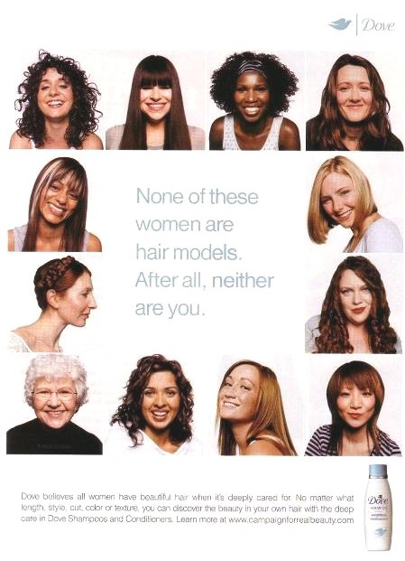
Dove’s campaign stresses the
everyday woman.
weblink
6 - 28

Slide 29
Interpretation
Physical Appearances
Stereotypes
First
Impressions
Jumping to Conclusions
Halo Effect
People hold meanings related to stimuli
Stereotypes influence how stimuli are perceived

Slide 30
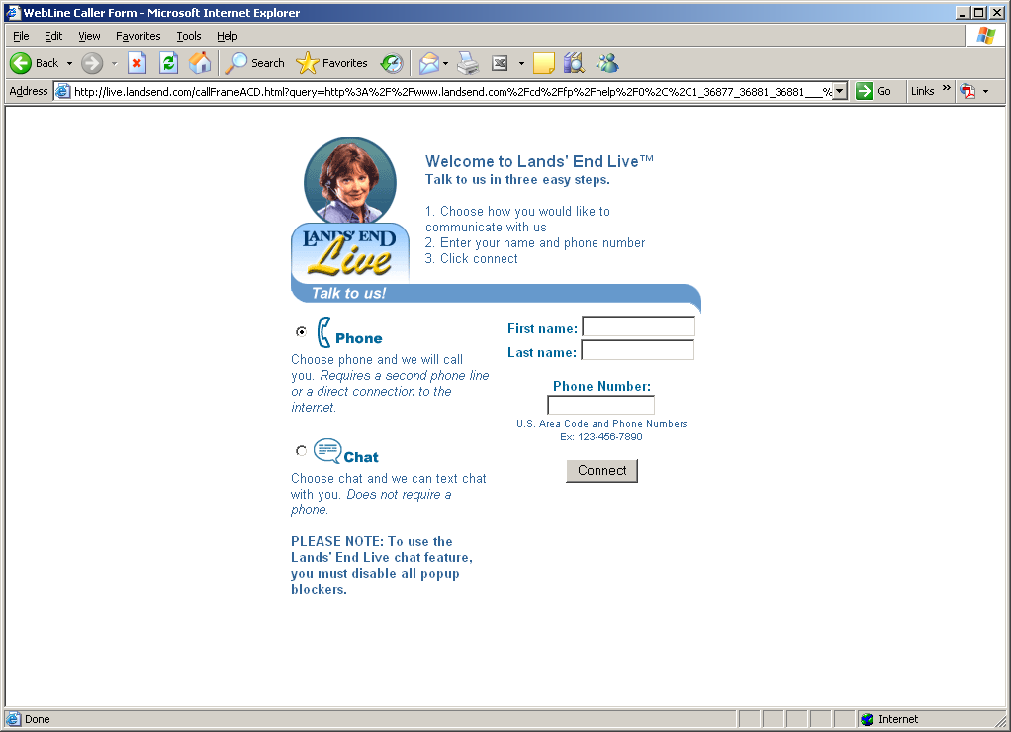
Putting a “Face” on Customer Service
weblink

Slide 31
Interpretation
Physical Appearances
Stereotypes
First
Impressions
Jumping to Conclusions
Halo Effect
First impressions are lasting
The perceiver is trying to determine which stimuli are relevant, important, or predictive

Slide 32
Interpretation
Physical Appearances
Stereotypes
First
Impressions
Jumping to Conclusions
Halo Effect
People tend not to listen to all the information before making conclusion
Important to put persuasive arguments first in advertising
6 - 32

Slide 33
Interpretation
Physical Appearances
Stereotypes
First
Impressions
Jumping to Conclusions
Halo Effect
Consumers perceive and evaluate multiple objects based on just one dimension
Used in licensing of names
Important with spokesperson choice

Slide 34
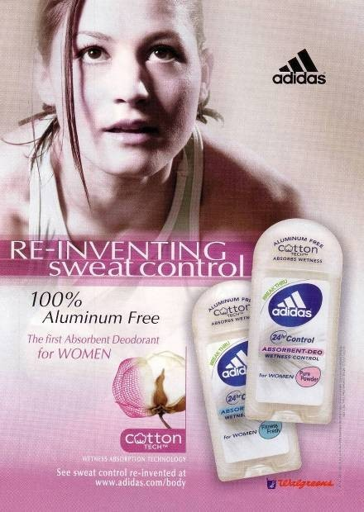
The halo effect helps Adidas break into new
product categories.

Slide 35
Issues in Consumer Imagery
Product Positioning and Repositioning
Positioning of Services
Perceived Price
Perceived Quality
Retail Store Image
Manufacturer Image
Perceived Risk

Slide 36
Positioning
Establishing a specific image for a brand in the consumer’s mind
Product is positioned in relation to competing brands
Conveys the concept, or meaning, of the product in terms of how it fulfills a consumer need
Result of successful positioning is a distinctive, positive brand image

Slide 37
Positioning Techniques
Umbrella Positioning
Positioning against Competition
Positioning Based on a Specific Benefit
Finding an “Unowned” Position
Filling Several Positions
Repositioning

Slide 38
Perceptual Mapping
A research technique that enables marketers to plot graphically consumers’ perceptions concerning product attributes of specific brands

Slide 39
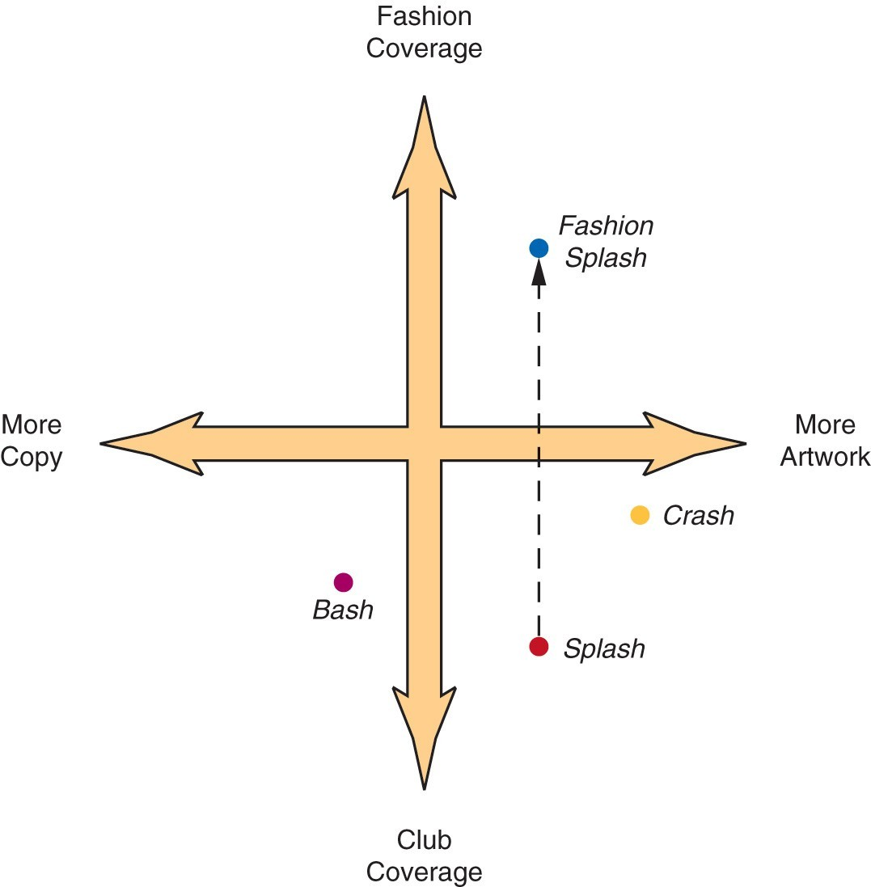
Perceptual Mapping Figure 6.14

Slide 40
Issues in Perceived Price
Reference prices – used as a basis for comparison in judging another price
Internal
External
Acquisition and transaction utility
One study offers three types of pricing strategies based on perception of value.

Slide 41
Three Pricing Strategies Focused on Perceived Value (Table 6-1)
Pricing Strategy | Provides Value By… | Implemented As…
Satisfaction-based pricing | Recognizing and reducing customers’ perceptions of uncertainly, which the intangible nature of services magnifies | Service guarantees Benefit-driven pricing Flat-rate pricing
Relationship pricing | Encouraging long-term relationships with the company that customers view as beneficial | Long-term contracts Price bundling
Efficiency pricing | Sharing with customers the cost savings that the company has achieved by understanding, managing, and reducing the costs of providing the service | Cost-leader pricing.

Slide 42
Acquisition-Transaction Utility
Transaction utility
The perceived pleasure or displeasure associated with the financial aspect of the purchase
Determined by the difference between the internal reference price and the purchase price
Acquisition utility
The consumer’s perceived economic gain or loss associated with the purchase
Function of product utility and purchase price

Slide 43
Perceived Quality
Perceived Quality of Products
– Intrinsic vs. Extrinsic Cues
Perceived Quality of Services
Price/Quality Relationship

Slide 44
Perceived Quality of Services
Difficult due to characteristics of services
Intangible
Variable
Perishable
Simultaneously Produced and Consumed
SERVQUAL scale used to measure gap between customers’ expectation of service and perceptions of actual service

Slide 45
A Scale Measuring Customer’s Perception of Call Center Employees (Table 6-4)
ATTENTIVENESS
The agent did not make an attentive impression.
The agent used short, affirmative words and sounds to indicate that (s)he was really listening.
PERCEPTIVENESS
The agent asked for more details and extra information during the conversation.
The agent continually attempted to understand what I was saying.
The agent paraphrased what had been said adequately.
RESPONSIVENESS
The agent offered relevant information to the questions I asked.
The agent used full sentences in his or her answers instead of just saying yes or no.
The agent did not recognize what information I needed.
TRUST
I believe that this company takes customer calls seriously.
I feel that this company does not respond to customer problems with understanding.
This company is ready and willing to offer support to customers.
I can count on this company to be sincere.

Slide 46
Table 6-4 (continued)
SATISFACTION
I am satisfied with the level of service the agent provided I am satisfied with the way I was spoken to by the agent. I am satisfied with the information I got from the agent.
The telephone call with this agent was a satisfying experience.
CALL INTENTION
I will very likely contact this company again.
Next time I have any questions I will not hesitate to call again.
I would not be willing to discuss problems I have with this company over the phone.

Slide 47
Price/Quality Relationship
The perception of price as an indicator of product quality (e.g., the higher the price, the higher the perceived quality of the product.)

Slide 48
Perceived Risk
The degree of uncertainty perceived by the consumer as to the consequences (outcome) of a specific purchase decision
Types
Functional Risk
Physical Risk
Financial Risk
Psychological Risk
Time Risk

Slide 49
How Consumers Handle Risk
Seek Information
Stay Brand Loyal
Select by Brand Image
Rely on Store Image
Buy the Most Expensive Model
Seek Reassurance

